Slide 1
Introduction to Enterprise Architecture
Chapter 1

Slide 2
Introduction to Enterprise Architecture
Architecture
Enterprise Architecture
The Architecture Process
Drivers for Enterprise Architecture
Internal Drivers
External Drivers
Summary

Slide 3
1. Architecture
Architecture is the fundamental organisation of a system embodied in its components, their relationships to each other, and to the environment, and the principle guiding its design and evolution.

Slide 4
1. Architecture
Stakeholder: an individual, team, or organisation (or classes thereof) with interests in, or concerns relative to, a system.

Slide 5
2. Enterprise Architecture
Architecture at the level of an entire organisation is commonly referred to as ‘enterprise architecture’
Enterprise: any collection of organisations that has a common set of goals and/or a single bottom line.

Slide 6
2. Enterprise Architecture
Enterprise architecture: a coherent whole of principles, methods,and models that are used in the design and realisation of an enterprise’s organisational structure, business processes, information systems, and infrastructure.

Slide 7
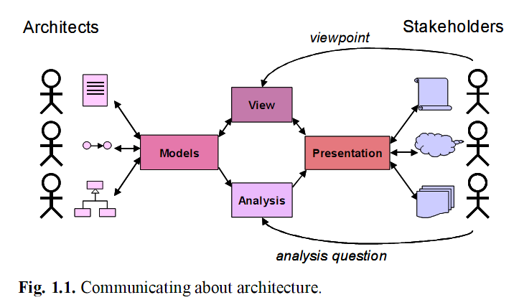
2. Enterprise Architecture
Even though an architecture captures the relatively stable parts of busi-
ness and technology, any architecture will need to accommodate change,
and architecture products will therefore only have a temporary status

Slide 8
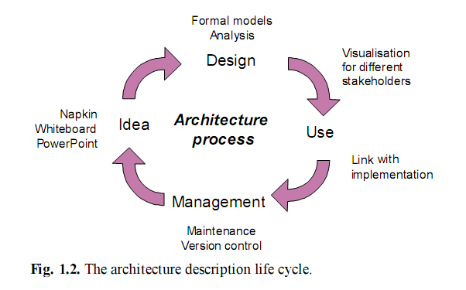
3. The Architecture Process

Slide 9
3. The Architecture Process
In all of the phases of the architecture process, clear communication with and between stakeholders is indispensable

Slide 10
4. Drivers for Enterprise Architecture
Internal Drivers
External Drivers
There are things, events, or situations that occur that affect the way a business operates, either in a positive or negative way. These things, situations, or events that occur that affect a business in either a positive or negative way are called "driving forces or environmental factors."

Slide 11
4.1. Internal Drivers
Internal driving forces are those kinds of things, situations, or events that occur inside the business, and are generally under the control of the company. Examples might be as follows
Organization of machinery and equipment
Technological capacity,
Organizational culture,
Management systems,
Financial management
Employee morale.

Slide 12
4.2. External Drivers
External driving forces are those kinds of things, situation, or events that occur outside of the company and are by and large beyond the control of the company. Examples of external driving forces might be, the industry itself, the economy, demographics, competition, po
External driving forces can bury a business if not appropriately dealt with. The question is, how does a business know what changes are occurring so that they can deal with them in a positive way. litical interference, etc.

Slide 13
Summary
Enterprise architecture, more specifically, is defined as a coherent whole of principles, methods, and models that are used in the design and realisation of an enterprise’s organisational structure, business processes, information systems, and infrastructure.
Architecture models, views, presentations, and analyses all help to bridge the ‘communication gap’ between architects and stakeholdersigning complex structures

